Slide 1
Simplifying SPI Communication
Mike Pool & Ian Knox

Slide 2
Motivation for SPI
Customer | US Qty/yr | Non-US Qty/yr | Total Qty/yr | One-Time | 2yr Qty
Control Systems | 150 | 15250 | 15400 | 2300 | 33100
Vision | 700 | 150 | 850 | 1000 | 2700
Test | 0 | 550 | 550 | 1600 | 2700
Vision & Motion | 1100 | 150 | 1250 |  | 2500
Asset Monitoring | 0 | 550 | 550 |  | 1100
Multi-Instr | 200 | 120 | 320 |  | 640
Vision
&
Motion
Embedded Camera,
Vision
High-Channel
Count AI
Vibration, Thermal
Monitoring
Dekstop
HIL
Control
Systems
SPI, I2C
EtherCAT
Camera
Camera,
Wireless, GUI
AI, Ethernet, Wireless

Slide 3
Outline
Motivation and Goals
Proposed Development Process
SPI API
Integration into existing application
SPI Configuration Editor
Summary

Slide 4
Goal of SPI API Effort
Make it easier for anyone to communicate with SPI Devices
Anyone who hasn’t communicated should get up and running soon (at least for simpler chips!)
Build Large Scale Systems using SPI

Slide 5


Targeted Customers
Big System…
SPI
PHIL
ROB
Where do I Start?
How can I get this chip up & running quickly?
How long does this take?
How do I abstract channels
How do I manage large channel count?
Can I finish this in time
cRIO Prototype to SOM

Slide 6
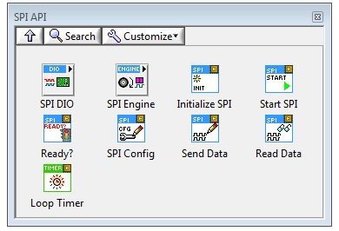
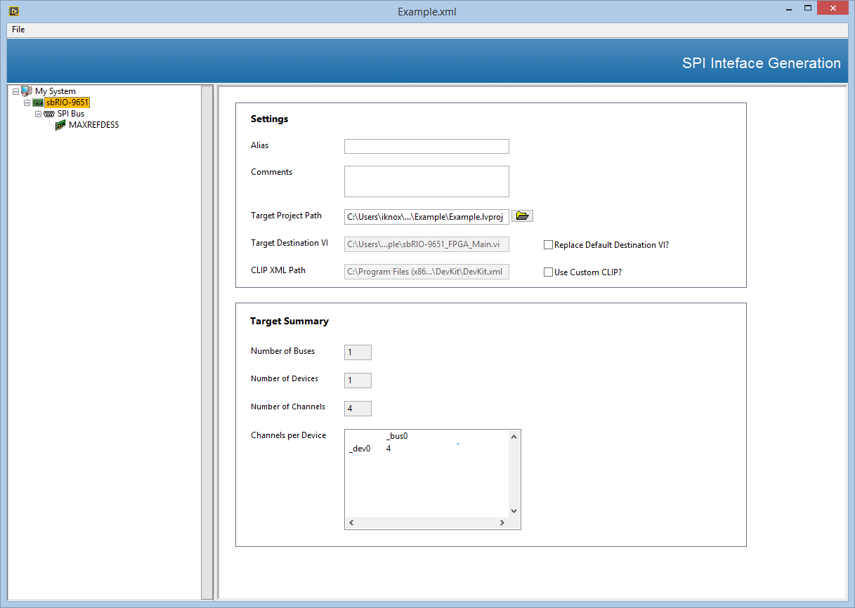
Targeted Customers
Big System…
SPI
Solution: SPI API
Solution: SPI Framework

Slide 7
Development Process
Communicate with one Device
Integrate with existing architecture
Scale the program to multiple channels/devices

Slide 8
Development Process
Communicate with one Device
Integrate with existing architecture
Scale the program to multiple channels/devices

Slide 9

Example Device: 16bit ADC
Make: Maximum Integrated
Reference Board Model: MAXREFDES5
ADC IC Model: MAX1301
Specs
16-bit
4 channel
5 V Supply
Communication using SPI

Slide 10



Device Configuration
Input
Channel Numbering
Channel # | C2 | C1 | C0
0 | 0 | 0 | 0
1 | 0 | 0 | 1
2 | 0 | 1 | 0
3 | 0 | 1 | 1
Output
Effective Calculation
Substitute and Adjust for Full Scale Range
where V_{REF} = 4.096 V
Notes:
http://datasheets.maximintegrated.com/en/ds/MAX1300-MAX1301.pdf

Slide 11

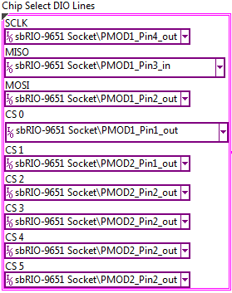
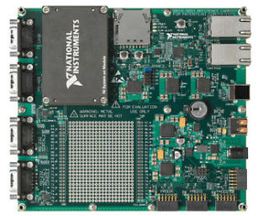
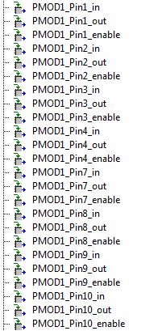
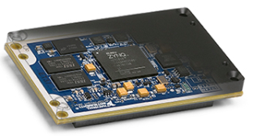
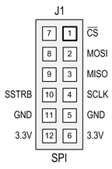
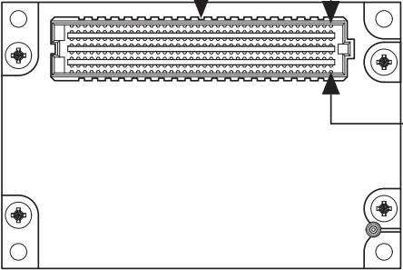
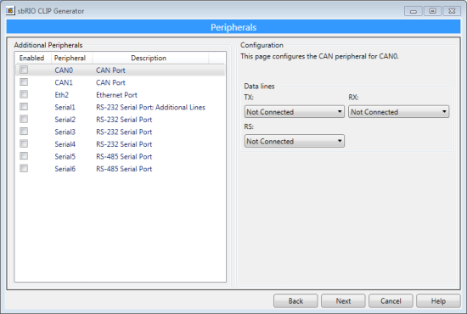
Data Path
Daughter
Board
LabVIEW FPGA
ADC
SOM
CLIP
ADC Pinout - PMOD Connector
SOM - J1 Connector
sbRIO CLIP Generator

Slide 12
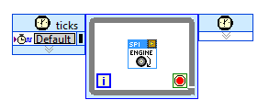
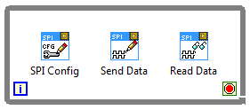
SPI API
Two parts
Engine
Logic
Parallel Execution
Notes:
Loops allow logic and engine to execute at different rates

Slide 13
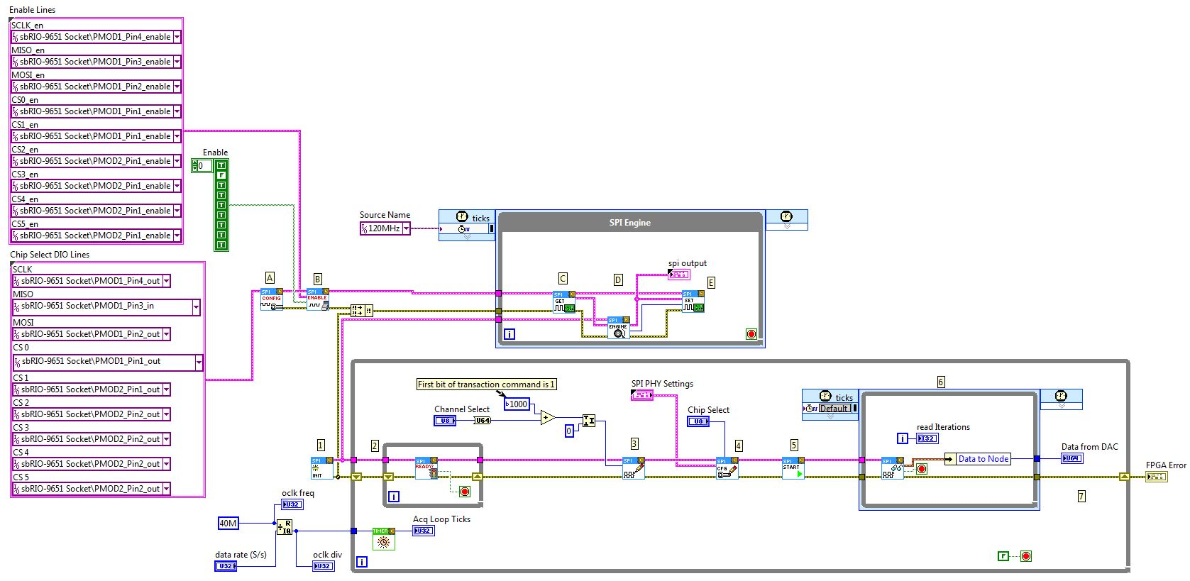
Prototype Code

Slide 14
Development Process
Communicate with one Device
Integrate with existing architecture
Scale the program to multiple channels/devices

Slide 15
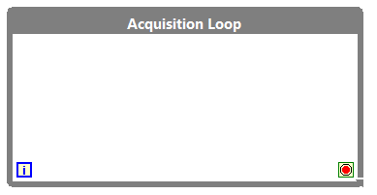

Incorporating the SPI API
Rob wants to incorporate Phil’s example into his architecture
Rob has been using a CompactRIO with the cRIO Waveform Reference Library

Slide 16
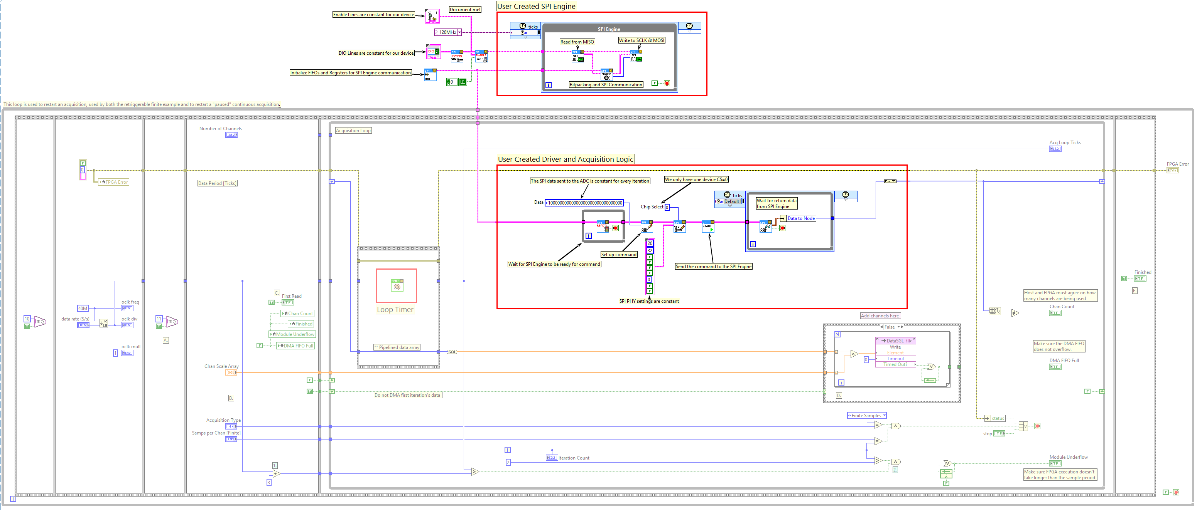
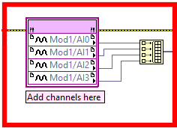
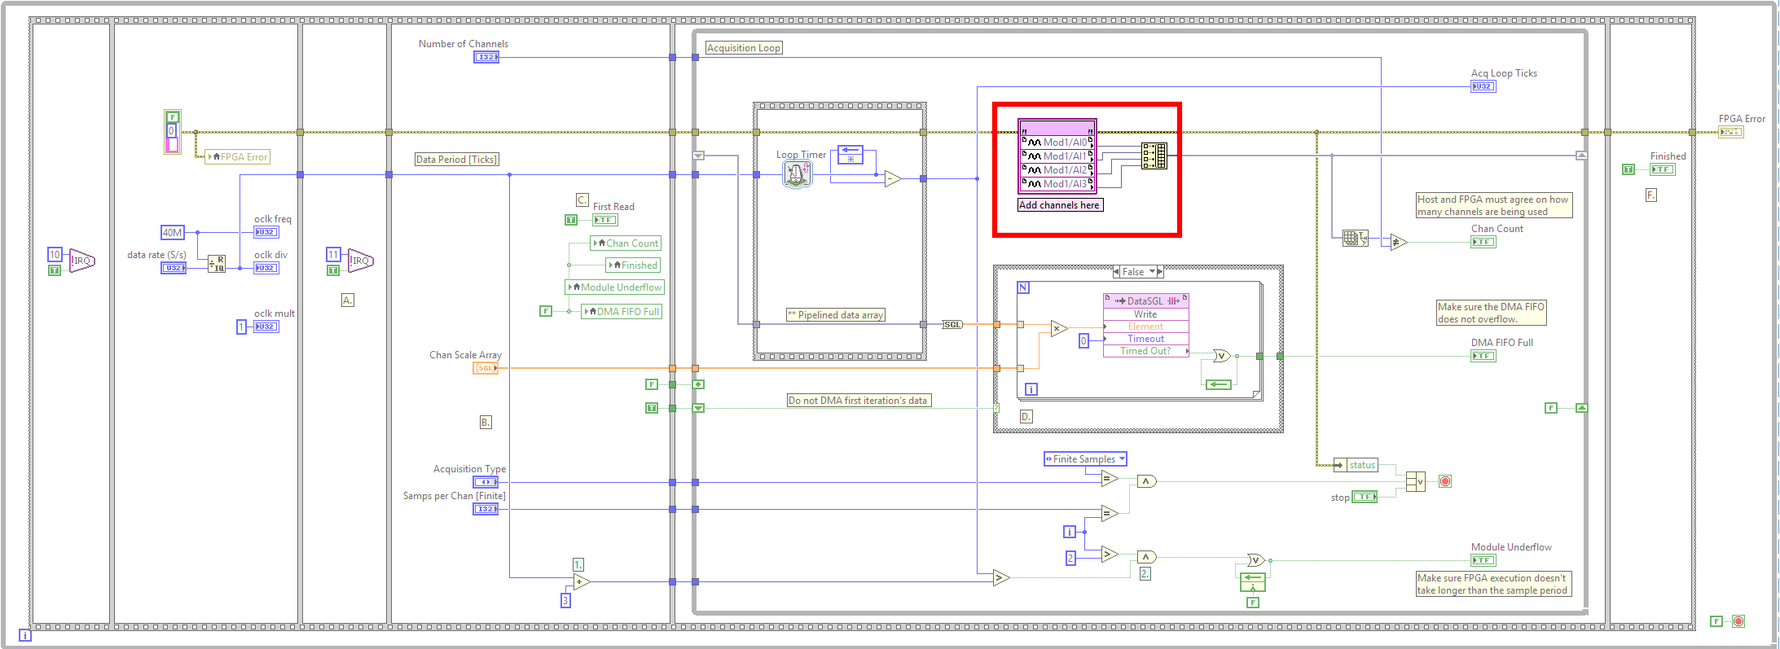
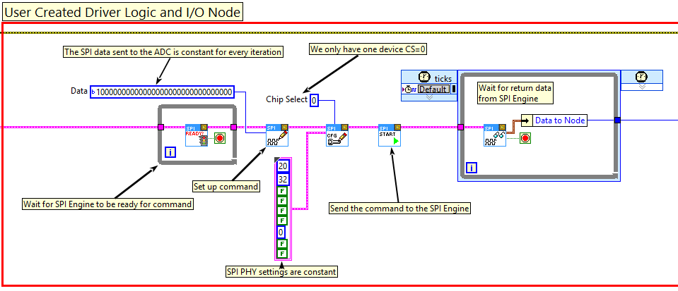

Slide 17
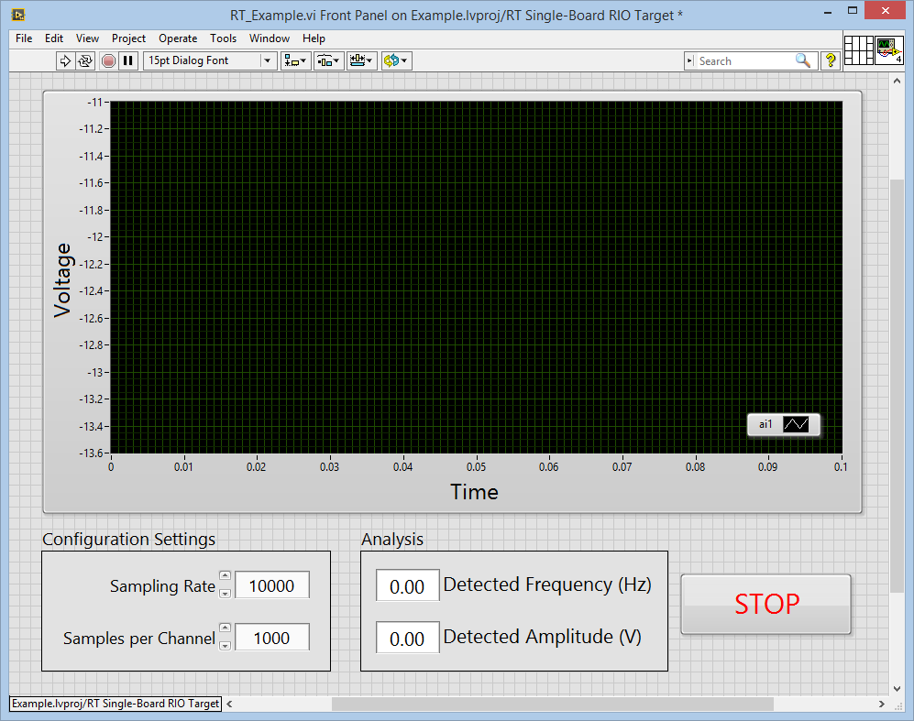
Single Channel Demonstration

Slide 18
Development Process
Communicate with one Device
Integrate with existing architecture
Scale the program to multiple channels/devices

Slide 19
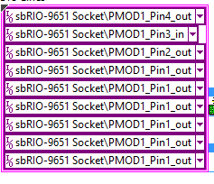
Adding Multiple Channels/Devices
Problem:
Arbitration Logic (only 1 SPI Engine)
Replicating channels increases development time
Adding multiple devices requires reselecting all I/O channels
Solution
Configuration based scripting
Notes:
Human Element – “Debugging Time” Errors etc.

Slide 20



Code Reorganization
Notes:
What happens to the timer?

Slide 21



Scaled Engine Communication
SPI Engine
Autonomous Engine Block
Driver Logic Unit
User Configured
Data Nodes
User Access

Slide 22
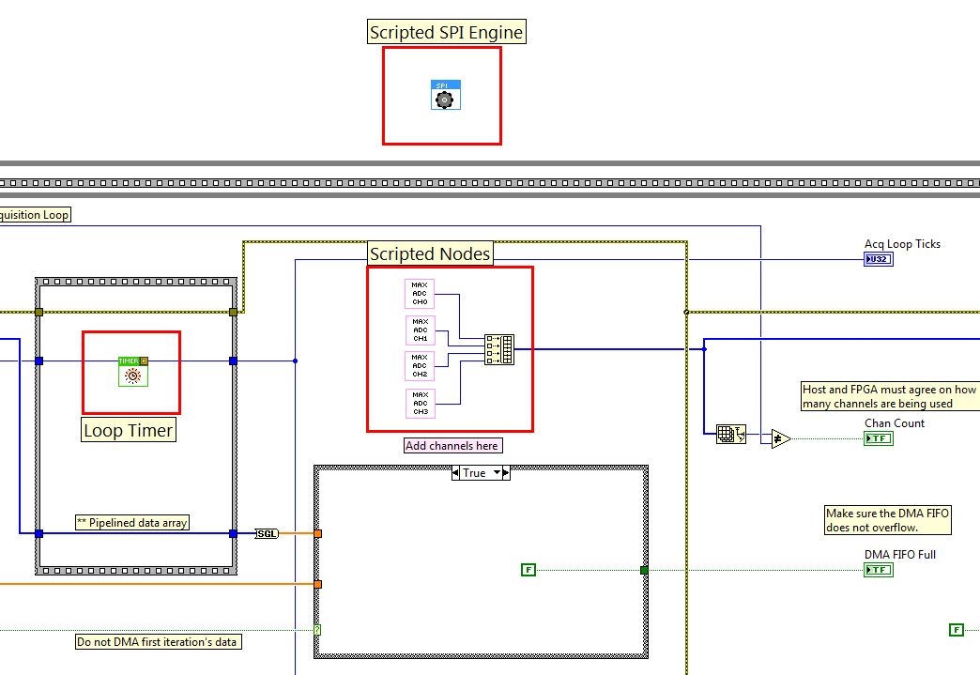

Slide 23
SPI Configuration Editor
Tree hierarchy
RIO Target
Bus
Device
Features
Code generation for multiple targets/devices
Replacement of DLU
Save functionality

Slide 24
Software Demo

Slide 25
Customization
SPI Engine
SE or Advanced LabVIEW FPGA
DLU
Customer/Alliance Partner
Node
Customer

Slide 26

Saving Development Time
Big System…
Solution: SPI API
Solution: SPI Framework
Approach | Development Time
Current | 1-2 Weeks
Goal | 1-2 Days
Approach | Development Time
Current | 3-4 Weeks
Goal | 3-4 Days
5x Reduction !!!

Slide 27
Deliverables
SPI API & SPI Framework
Code (API, Sample Project)
Getting Started Guide
Video Tutorials
White Paper on the Web
Hands-On Session at Alliance Day / NI Week
Notes:
Getting Started Guide will have Debugging Steps

Slide 28
Deliverables
Deliverable | Status
Code (API, Sample Project) | 70% Complete
Getting Started Guide | 30% Complete
Video Tutorials | Pending
White Paper on the Web | Pending
Hands-On Session at Alliance Day / NI Week
Notes:
https://github.com/kalyanramu/SPIFramework

Slide 29
SPI API Project
Overall Status
Q1 15
Q2 15
Q3 15
Q4 15
Q1 16
Code Development
Code Review
Video Tutorials
Code Packaging
Documentation
Today
On Target
At Risk
Missed
Projects | Phase/Milestone | Status
Reuse IP | Code Development | Complete
 | Code Testing | Complete
 | Code Review | On Track
 | Documentation | Missed
 | Code Packaging | Missed

Slide 30
SPI Framework
Overall Status
Q1 15
Q2 15
Q3 15
Q4 15
Q1 16
Code Development
Code Review
Code Packaging
Documentation
Video Tutorials
On Target
At Risk
Missed
Today
Projects | Phase/Milestone | Status
Reuse IP | Code Development | On Track
 | Code Testing | On Track
 | Code Review | On Track
 | Documentation | Missed
 | Code Packaging | Missed

Slide 31
Workflow
Configure SPI Settings
Simulate the system to get waveform
Download to FPGA and test communication
Create Driver Logic Unit
Create Wrappers for the Node Interface

Slide 32
Demo Points
WorkFlow
Prototyping using SPI API
Create I/O Node Style Interface
Integrate into cRIO Waveform

Slide 33
Special Thanks!
Code Development
Ryan Poulos and Shane Coles (SPI API)
Consulting
Andrew Heim – Architecture Discussions
Benjamin Celis and Daniel Smith – Configuration Editor
Chris Malato – Packaging

Slide 34
Mistakes/ Lessons Learnt
Requirements Gathering
It wasn’t complete
Code Reviews
Defining Stake Holders and holding them responsible

